Slide 1
2024-25 TITLE I ANNUAL MEETING
Turner Elementary
September 11, 2024
5pm
Tonight's Agenda:
Welcome families
Overview of our Title I Program
School Improvement Plan Goals
Testing Schedule
Upcoming Parent Trainings/Events
School Compact
Parents Right to Know
Exit Slip
FY25
Notes:
The purpose of the annual meeting is to explain this year’s Title I program to your families. Feel free to adjust the agenda, I’ve just given you a sample.

Slide 2
WHAT IS TITLE I?
Title I is the largest federal program supporting education!
Title I funds must be used for the following:
Support the academic growth of all students attending Title I schools.
Provide extra support to those students that are the furthest from meeting the state standards.
Train families and provide resources so they can successfully help their children at home and improve academic achievement.
FY25

Slide 3
WHO DECIDES HOW FUNDS ARE USED?
Your administrative team considers data and feedback collected throughout the school year to write the school’s Title I Plan. The team at Turner Elementary is Ashley Toll and Sara Keller.
Every school has a School Advisory Council (SAC) composed of parents, teachers, staff, community members, administrators, and students (at middle and high schools) that reviews the draft Title I Plan and makes suggestions.
Please consider joining the School Advisory Council… we need your voice!
Copies of the Title I Plan and the School Improvement Plan (SIP) are available for families in the
Title I Parent Notebook in the front office.
FY25

Slide 4
How are Title I funds helping our school this year?
(Turner ) is provided with $344,736 to pay for highly qualified teachers, instructional coaches, professional development for teachers, and programs for our students.
School-based Title I funds pay for the following:
Interventionists
Math Coach
Literacy Coach (0.5 funded by district)
Intervention materials, parent & family engagement materials, technology, professional development
Turner’s 5th graders also participate in the STARBASE program
All of our Title I funds support our School Improvement Plan (SIP) goals.
FY25
Notes:
On this page you might want to explain to families when interventions will start, how students are selected, etc.

Slide 5
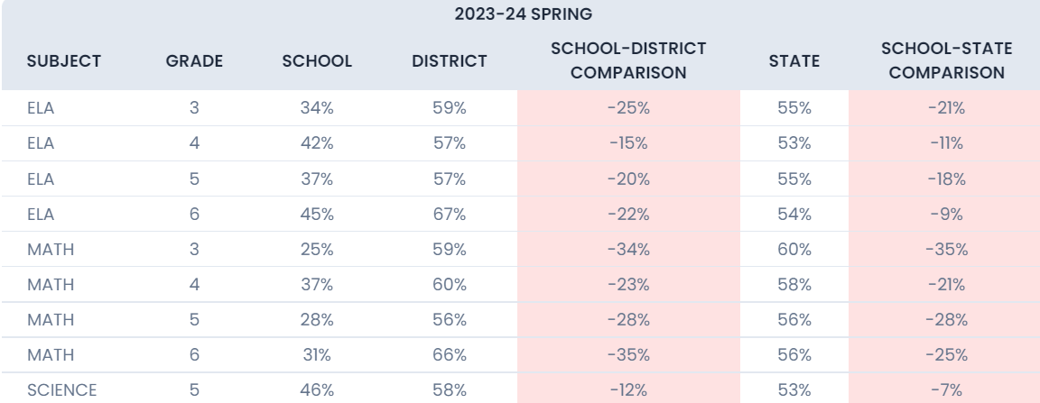
2023-24 ASSESSMENT RESULTS
FY25

Slide 6
2024-25 SCHOOL IMPROVEMENT PLAN (SIP) GOALS
Goal 1: Grades K-2 :By the Spring 2025 STAR literacy achievement will increase by 15%. We will be monitoring ELA proficiency through STAR early literacy progress monitoring assessments. Grades 3-5: By the Spring 2025 FAST, literacy achievement will increase by 15%. We will be monitoring ELA proficiency through FAST progress monitoring assessments.
How: Kagan Cooperative Learning Structures, working with coaches, utilizing interventionists
Goal 2: Grades K-2: Grade level progress monitoring indicates a need for explicit math instruction in grades K-2 to decrease the number of students entering 3rd grade below grade level. i-Ready data indicates that only 19% of third grade students are entering the year on grade level. 23% of current third graders are entering 2 or more grade levels below in math. This trend data indicates a priority action is to improve instructional delivery in grades K-2. Based on the Spring i-Ready math Diagnostic, 70% of 1st graders, 90% of 2nd graders, and 81% of 3rd graders are starting the 24-25 below grade level.
How: Kagan Cooperative Learning Structures, working with coaches, utilizing interventionists
FY25
Notes:
We want families to see that what school are spending their Title I money on is directly tied to the SIP goals.

Slide 7
Florida’s EDUCATIONAL STANDARDS
Florida’s academic content standards establish high expectations for all students in the areas of reading, mathematics, writing, and science
The Florida Benchmarks for Excellent Student Thinking (B.E.S.T.) Standards for Language Arts and Math identify what your child needs to know and be able to do. Information can be found at:
www.cpalms.org Click on the “Standards” tab at the top of the page
If you need help accessing the B.E.S.T. Standards on Cpalms
please ask your child’s teacher ☺
FY25

Slide 8
2024-25 SCHOOL ASSESSMENTS
STAR & FAST testing: PM1 (3-6)
Paper copies of the testing results will be sent home to parents after the testing window is complete.
PM1 3-6 8/27-8/28; K-2 9/10-9/11
PM2 3-6 12/3-12/4; K-2 12/10-12/11
PM3 4-6 5/1 & 5/6; K-2 4/22-4/23
Curriculum:
ELA – Benchmark (K-5); SAVAAS (6th); Math – ; Science
Parents and families can request to have their child’s test scores reviewed/explained to them by a member of the school staff at any time!
Please let your child’s teachers know if would like that opportunity!
FY25

Slide 9
PARENT SURVEY RESULTS
Parents requested more family fun nights. We are bringing back Trick or Treat night and Dr. Seuss Night
Please make sure to contact your child’s teacher throughtout the school year by phone or email
Parents stated that FOCUS emails and newsletters were the best forms of communication from the school
We are looking for more participation in these surveys. Please be on the lookout in your FOCUS email, website and/or Facebook for more opportunities for input.
FY25
FY25

Slide 10
PARENT AND FAMILY ENGAGEMENT PLAN (PFEP)
Each Title I school must annually write, with input from families, teachers, and community members a written Parent and Family Engagement Plan (PFEP). Families will be receiving a brochure highlighting the main parts of our PFEP.
Upcoming 2024-25 Parent Events
We will be having multiple parent and family events throughout the school year. Trick or Treat, Math Night, Science Gross Out Night, Dr. Seuss Night – please check our newsletter, website and/or Facebook page for notifications.
The district Parent and Family Engagement Plan (PFEP) can be found in the Title I Parent Notebook in the front office, on our website under “Title I”, or on the district website under “Federal Programs”, then “Title I”.
FY25
Notes:
Tell families when they will be getting the PFEP brochures, if not being given out the night of your annual meeting. Also let them know they will be in your front office with the Title I Parent Notebook.

Slide 11
SCHOOL-PARENT COMPACT
Each school must have a School-Parent Compact that is jointly developed with parents.
The compact outlines how parents, the entire school staff, and students will share the responsibility for improved student academic achievement.
The compact is required to be revised each year using input from parents, students, and teachers.
FFY25
Y25

Slide 12
2024-25 SCHOOL-PARENT COMPACT
Working together for success:
In the classroom Teachers will plan and provide high-quality standards-based lessons that enable students to meet the state’s academic achievement standards.
At Home Families will ensure that their child attends school regularly, arrives on time and is prepared to learn.
Student responsibility Students will share the responsibility to improve academic achievement, come prepared for class, complete classwork and homework assignments.
Communication is critical! Please be sure your child’s teacher has up-to-date contact information. Our school uses FOCUS emails. Frequent, two-way communication between teachers and families leads to trusting relationships and a positive school year.
FFY25
Notes:
This page is just an overview of your school compact. You do not need to copy/paste your compact on the page. Keep it simple, with the most important things you want your families to remember about the compact.

Slide 13
Parents Right-To-Know
If your child’s teacher(s) is qualified and state-certified for the grade and subject area they are teaching. Parents may request information regarding the professional qualifications of their child’s classroom teacher at any time.
The instructional assistant working with your child is highly qualified.
If your child has been taught for 4 or more consecutive weeks by a teacher who does not meet state certification or licensing. Parents will be notified in writing.
Your child’s academic progress: standardized test results (STAR, FAST), intervention/progressing monitoring results, and classroom grades
FFY25

Slide 14
TIPS FOR SUCCESS:
Communicate with your child’s teacher often throughout the year! Start at the beginning of the year…how do you want to communicate with each other?
Give your input on the schools Title I Plan (please fill out exit slips, Google Forms, surveys, etc.)
Consider joining the PTO/PTA, School Advisory Council (SAC) or the District Parent Leadership Team. Let your voice be heard!
Turner has a Parent Resource Centers that provide materials that families may check out to use at home. You may also ask your child’s teacher for materials to help you at home.
Reach out to Megan Arnold (arnold.megan@brevardschools.org) to discuss available materials
FY25
Notes:
Discuss your parent resource room, what is offered, and what is available. If you don’t have a room with materials, how do parents go about getting them (check out system, etc.)

Slide 15
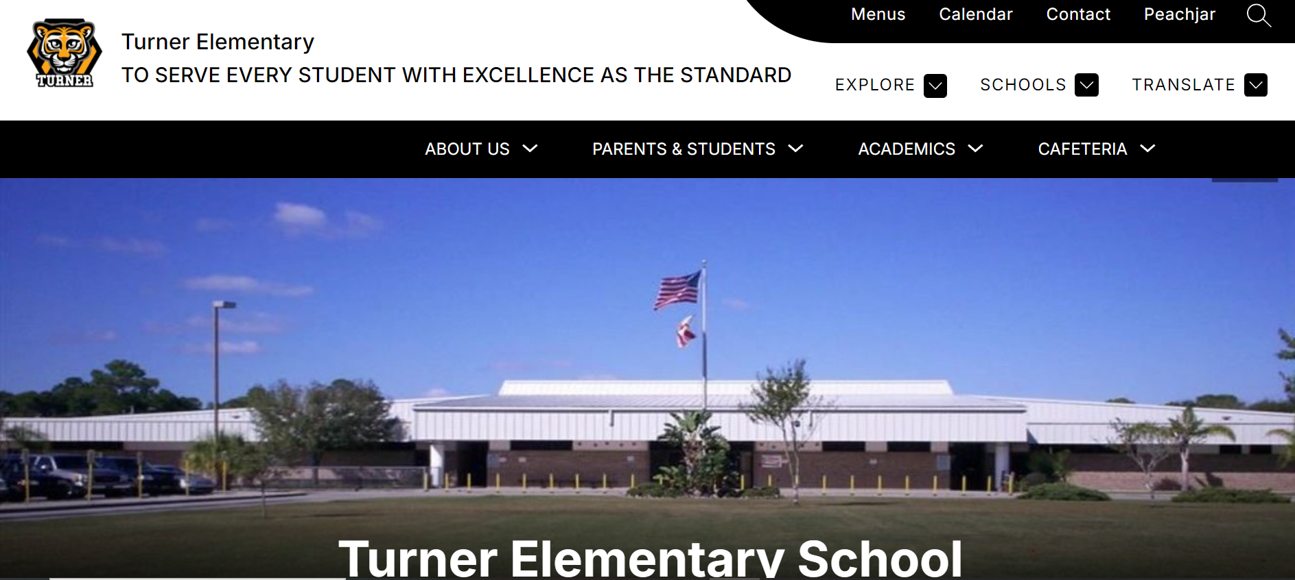
WAYS TO STAY INFORMED
https://turner.brevardschools.org/
Follow us on Facebook: John F. Turner Elementary https://www.facebook.com/TurnerElementaryOfficialSite
FY25
Notes:
Pull up your school website, show parents how to get to the Title I page and other important areas. This is important because we have a totally new website, and some families may not know how to navigate it yet.

Slide 16
BEFORE YOU LEAVE!
Don’t forget to sign up for your FOCUS account. Monitor your child’s grades and stay in touch with their teacher!
Please consider volunteering in your child’s classroom this year! We’d love to have you!
Please complete the Annual Meeting Feedback form. Your opinions matter to us!
FFY25
Y25

